Slide 1
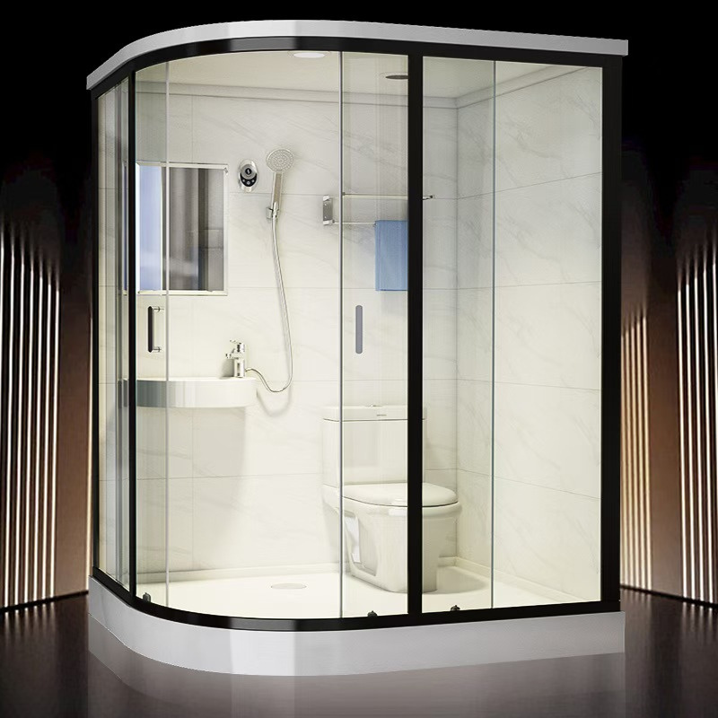

Dome Bathrooms & Specifications
Domespaces® offers the largest selection of domes in the market! Now also offering prefab bathroom solutions designed to integrate seamlessly with our dome structures.
domespaces.com

Slide 2
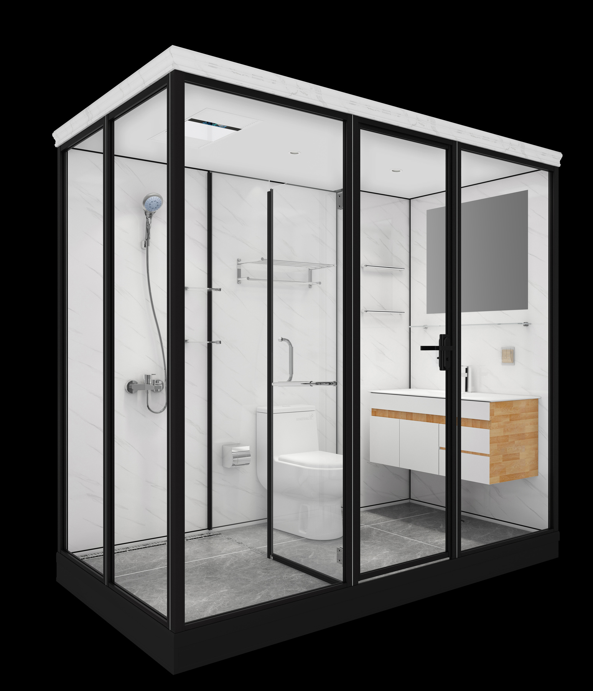
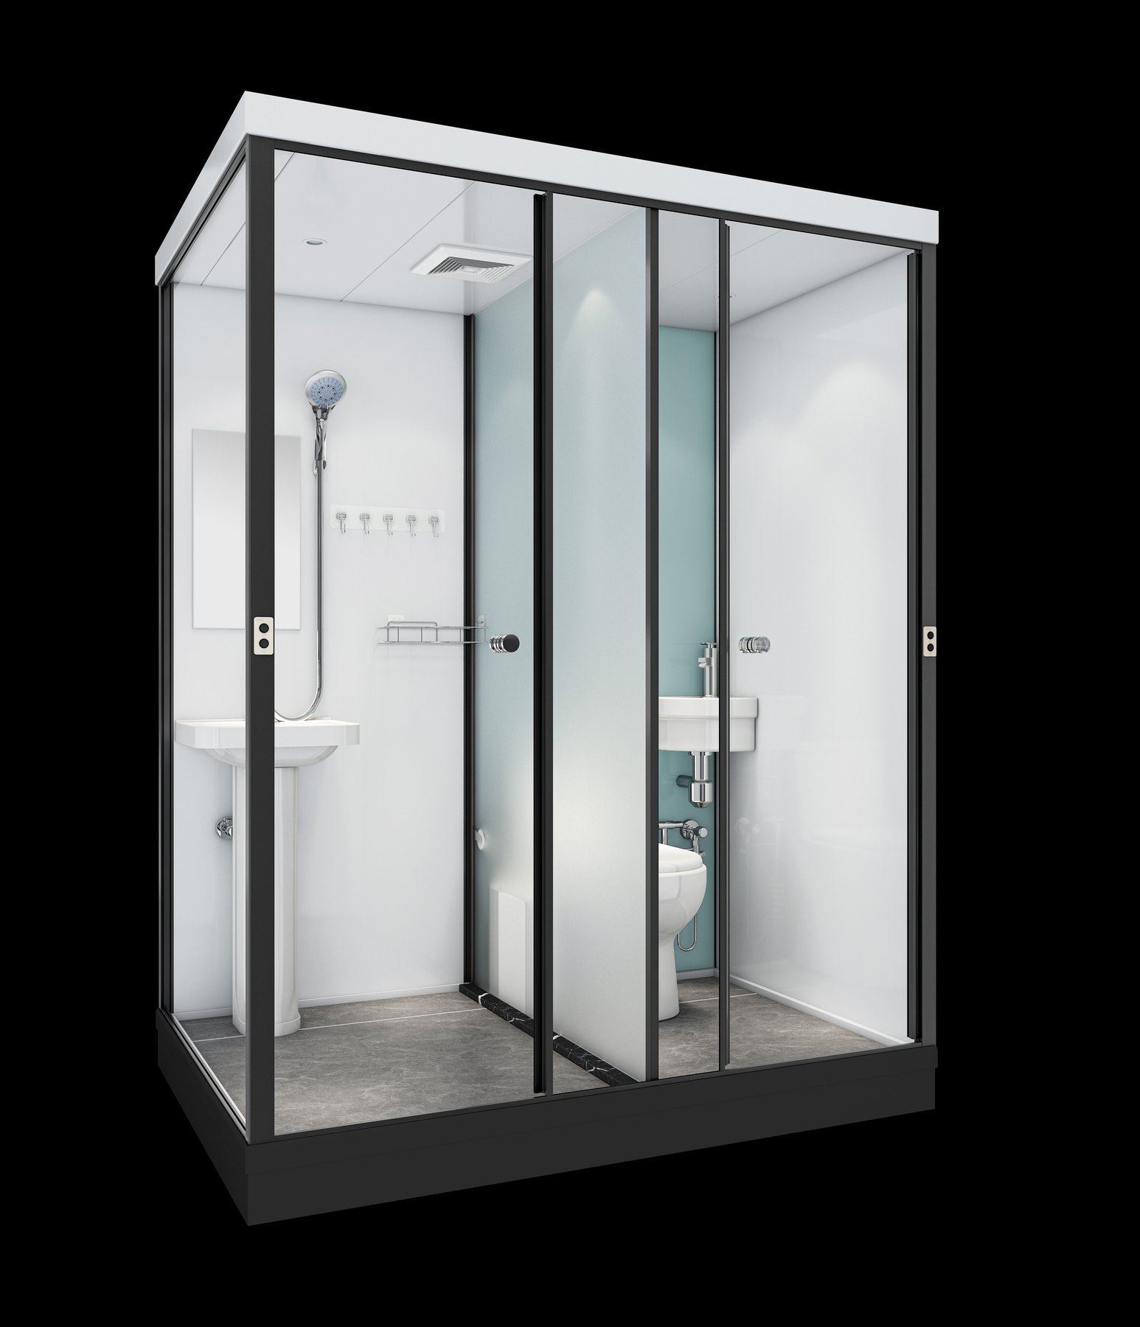
Model MBR 496
MBR 400
MBR 409
Model: MBR496
Models
Overview
MBR 496
MBR 400
MBR 409

Slide 3
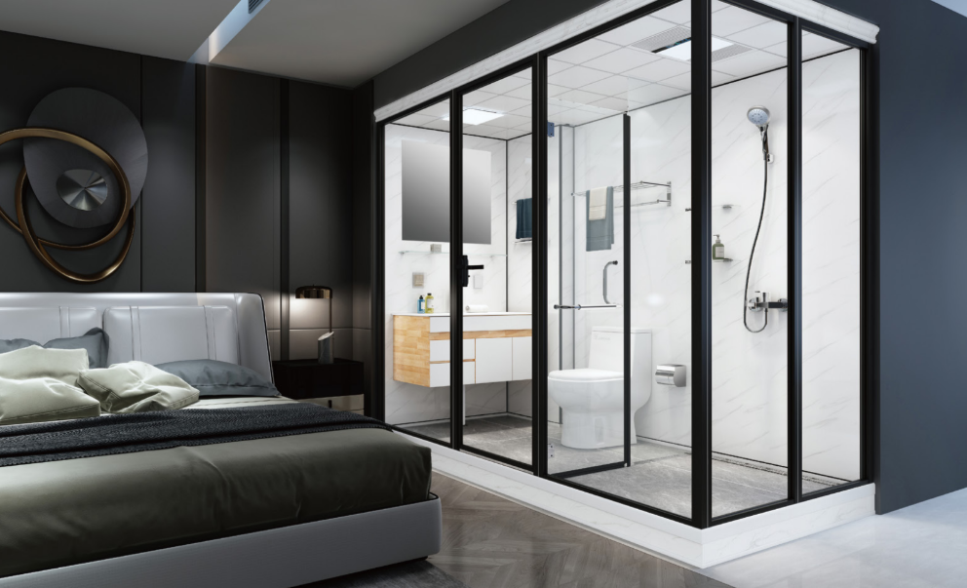
Model: MBR 496

Slide 4
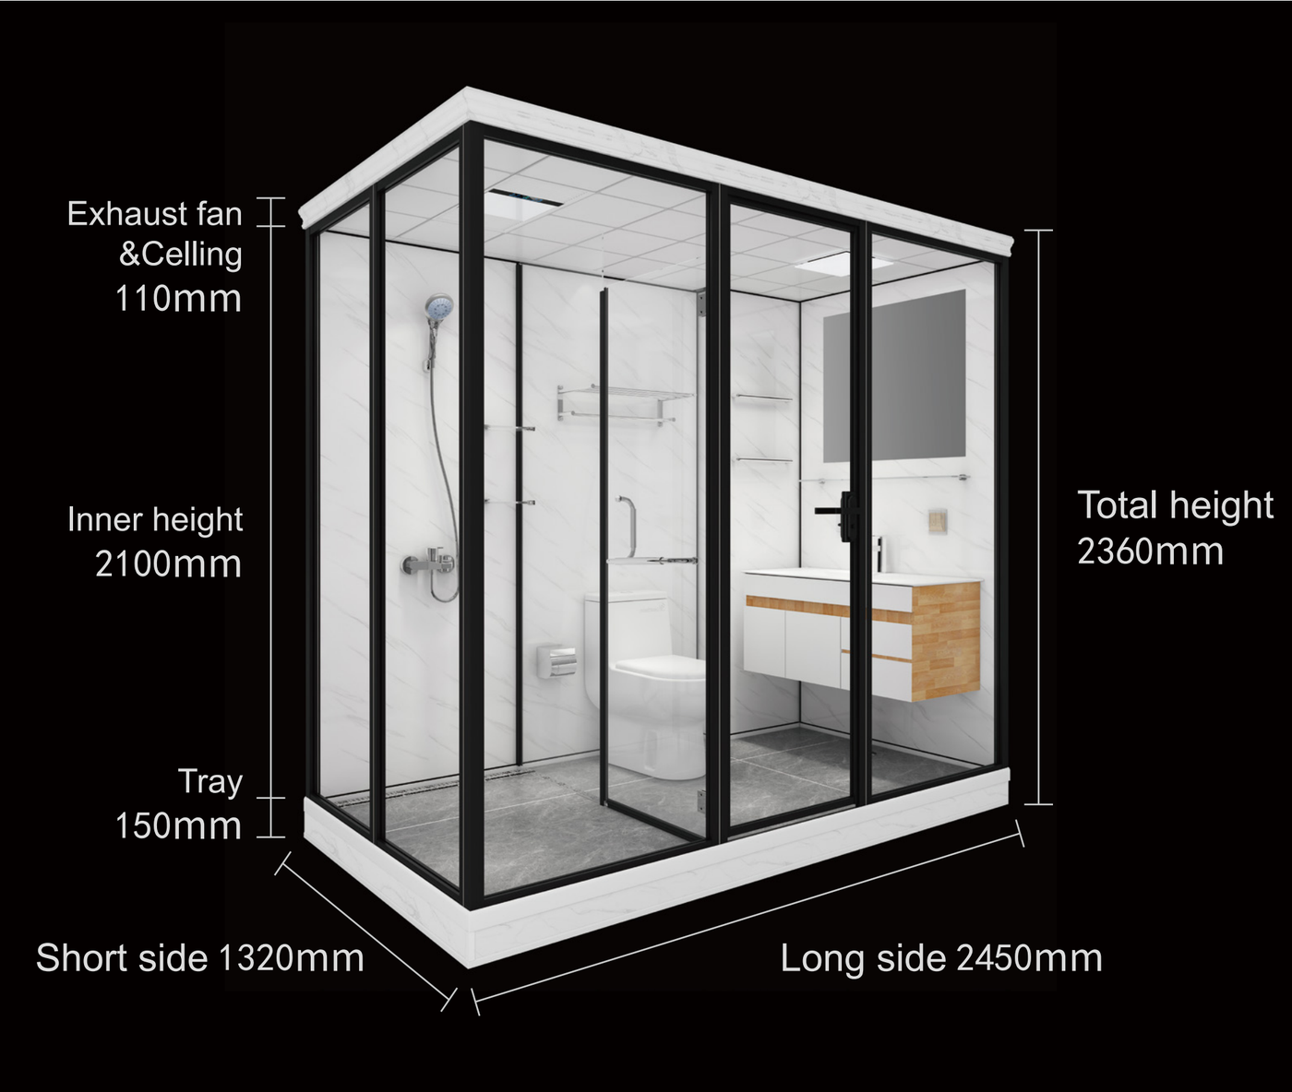
Model MBR 496
MBR 400
MBR 409
Model MBR 496
Overview
4.3 inches
Suitable for all prefab buildings
Size and Specifications
  Domes
  Yurts
  Tents
  Containers
  Air Domes
  Aviation aluminum alloy
  Washing Area
  Bathroom Area
  Toilet Area
  Tempered Glass
82.68 inches
93 inches
Left & right side configuration
All-in-one bathroom unit
5.9 inches
52 inches
96.5 inches

Slide 5
Model MBR 496
MBR 400
MBR 409
Model MBR 496
Sizes & Specifications
Main parameters | Main parameters
Size | 1320 x 2450 x 2360mm I 52 × 96.5 × 92.9 inches
Inner Height | 2100mm I 82.68 inches
Gross Weight | about 533kg I 1175lbs
Packing Volume | about 2.60m³ I 91.82 cubic feet
Body | 5mm (3/16 inch) tempered glass+ explosion proof film
Back Board | 5mm (3/16 inch) tempered glass+ explosion proof film
Frame | Aviation aluminum alloy
Main parameters | Main parameters
Tray | Integrated PVC leakage proof tray + ceramic tiles
Roof | Aluminous gusset plate
Door | Push-and-pull door(with lock)
Water-entering Pipe | PPR
Sewage Pipe | PVC
Floor Drain | Odor and blockage prevention

Slide 6
Model MBR 496
MBR 400
MBR 409
Model MBR 496
Sizes & Specifications
Washing area | Washing area
Basin | Ceramic integrated basin (countertop size: 1000 x 460mm I 39.4 × 18.1 inches)
Faucet | Main body: Copper I Surface: Chrome plated
Cabinet | Wooden bathroom cabinet
Mirror | Single silver mirror
Towel Hanging Rod | 304 stainless steel
Back Board | 5mm (3/16 inch) tempered glass+ explosion proof film
Towel Shelf | 304 stainless steel
Toilet Area | Toilet Area
Toilet | Premium siphon type fully glazed toilet
Toilet Paper Box | 304 stainless steel
Bathing Area | Bathing Area
Shower | Hand hold shower: main body copper
Shower Screen | 6mm (1/4 inch) tempered glass + explosion proof film
Commodity Shelf | 8mm (5/16 inch) grade tempered glass

Slide 7
Model MBR 496
MBR 400
MBR 409
Model MBR 496
Sizes & Specifications
Electric Appliance | Electric Appliance
Bath Heater | With 3 in 1 function of exhausting, heating and lighting
Light | LED light
Switch | One internal
Socket | One internal

Slide 8
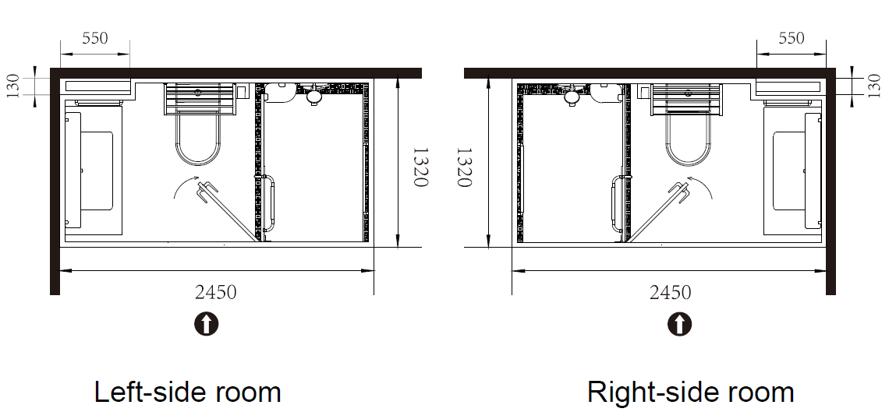
Model MBR 496
MBR 400
MBR 409
Model MBR 496
Configurations

Slide 9
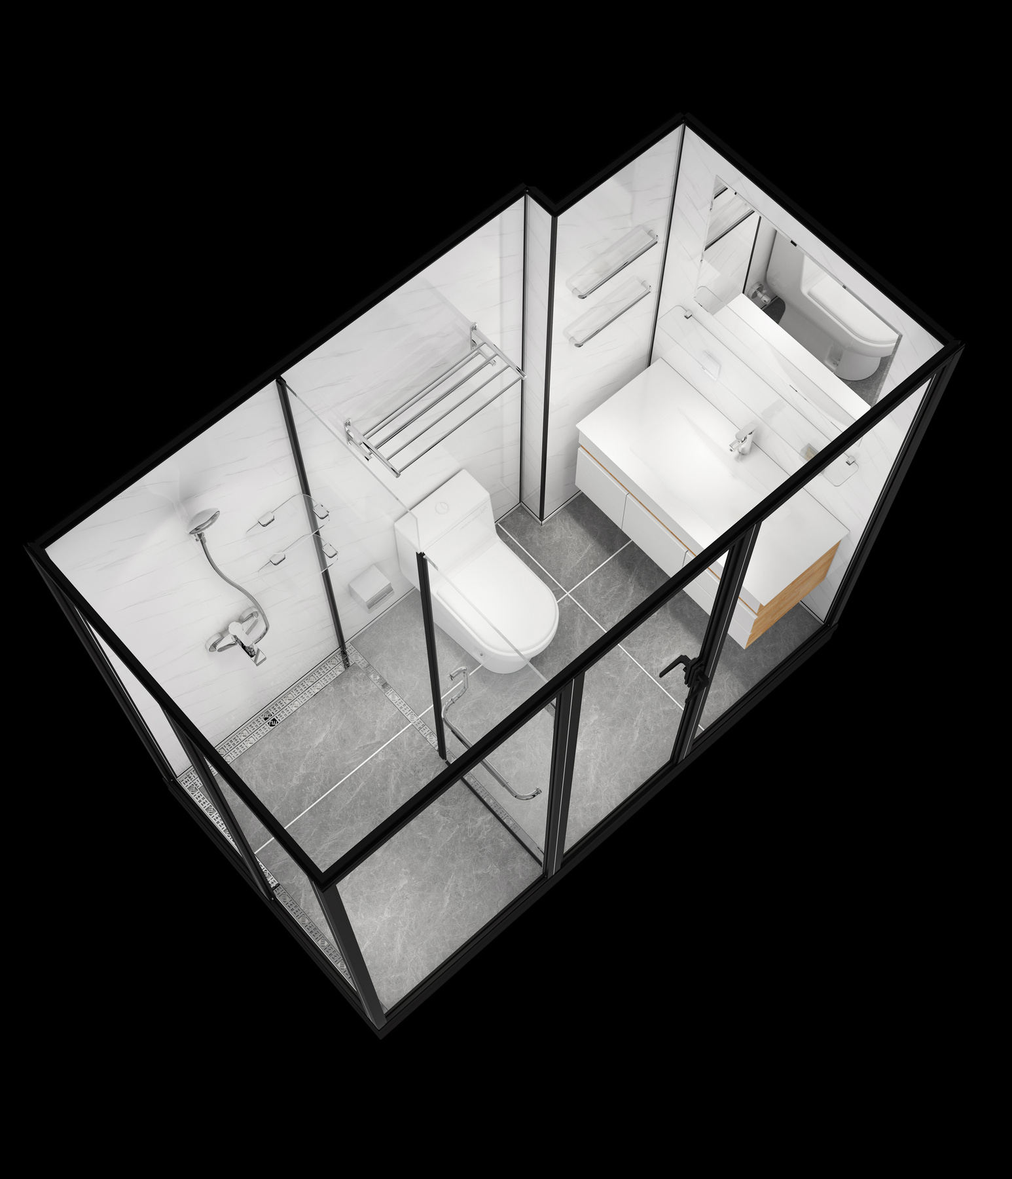
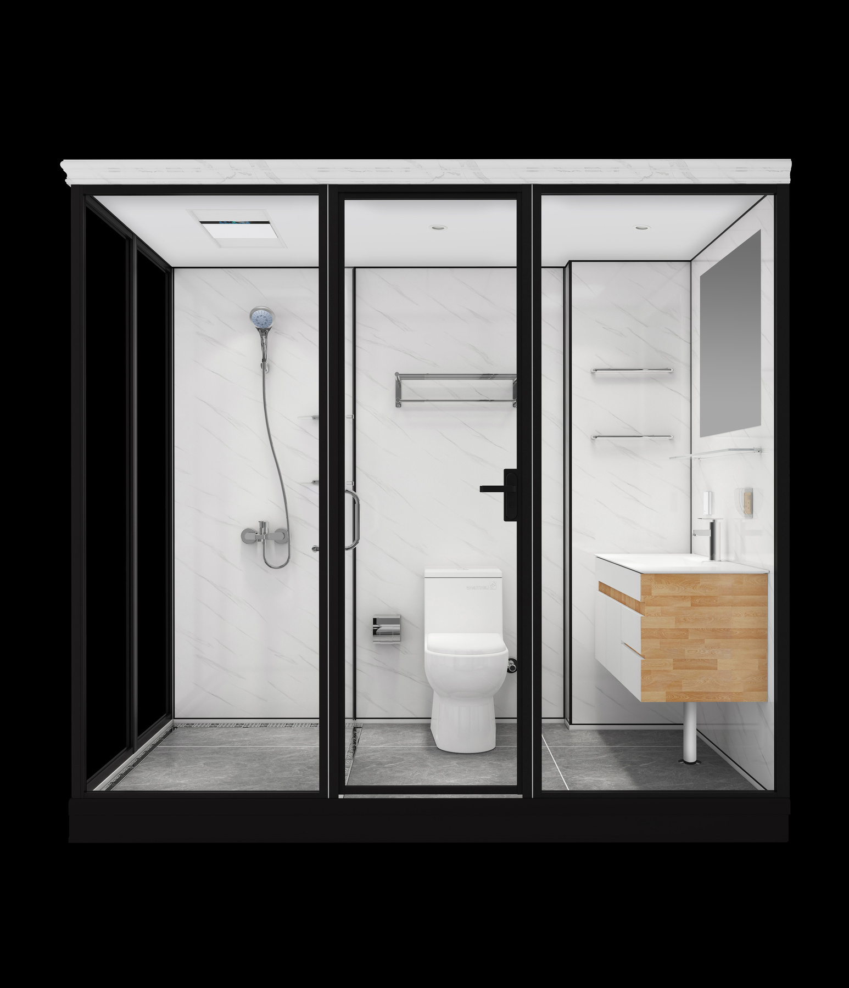
Model MBR 496
MBR 400
MBR 409
Model MBR 496
Gallery

Slide 10
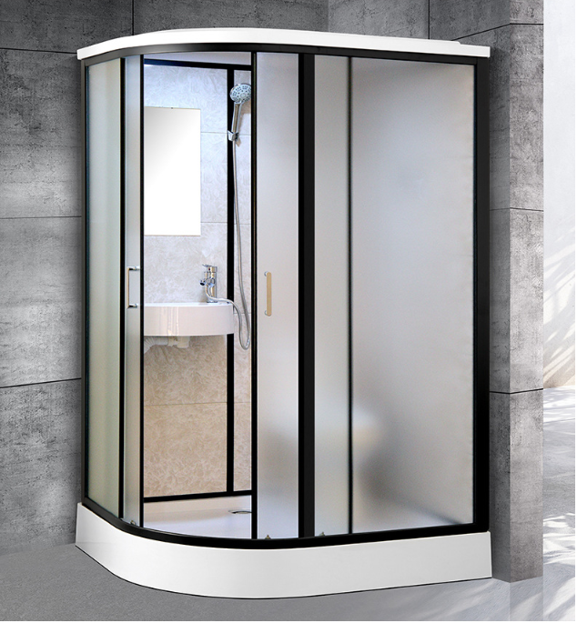
Model: MBR 400

Slide 11
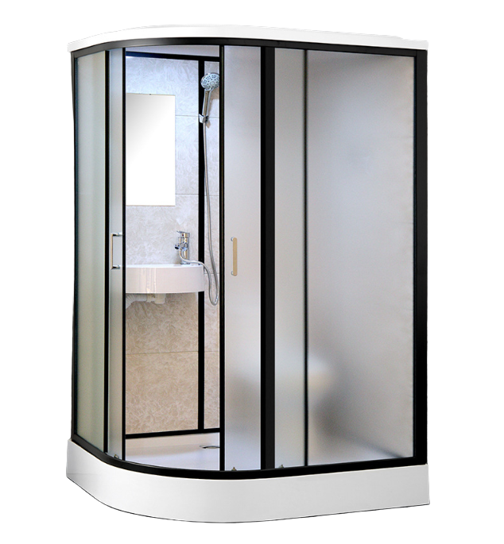
Model MBR 496
MBR 400
MBR 409
Model MBR 400
Total Height
2150mm
84.65 inches
Overview
Suitable for all prefab buildings
Size and Specifications
  Domes
  Yurts
  Tents
  Containers
  Air Domes
  Washing Area
  Bathroom Area combined w. Toilet Area
  Sliding Door
  Tray Material: ABS
Short Site
1100mm
43.3 inches
Left & right side configuration
All-in-one bathroom unit
Long Site
1400mm
51.2 inches

Slide 12
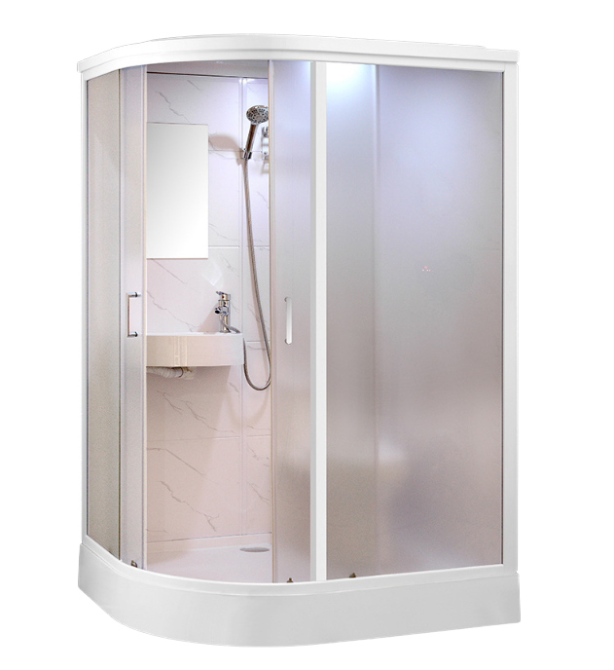
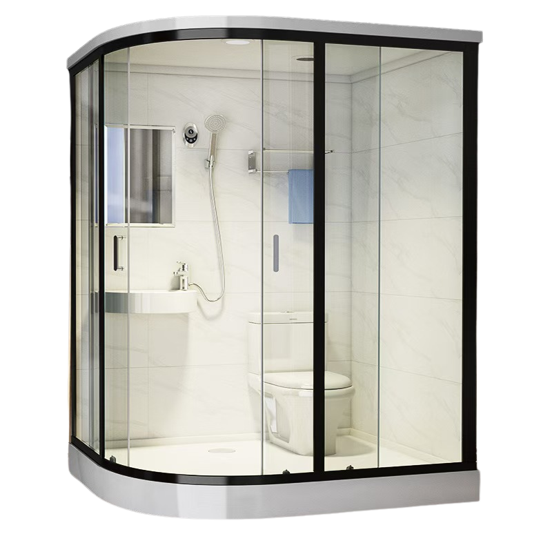
Model MBR 496
MBR 400
MBR 409
Model MBR 400
Gallery

Slide 13
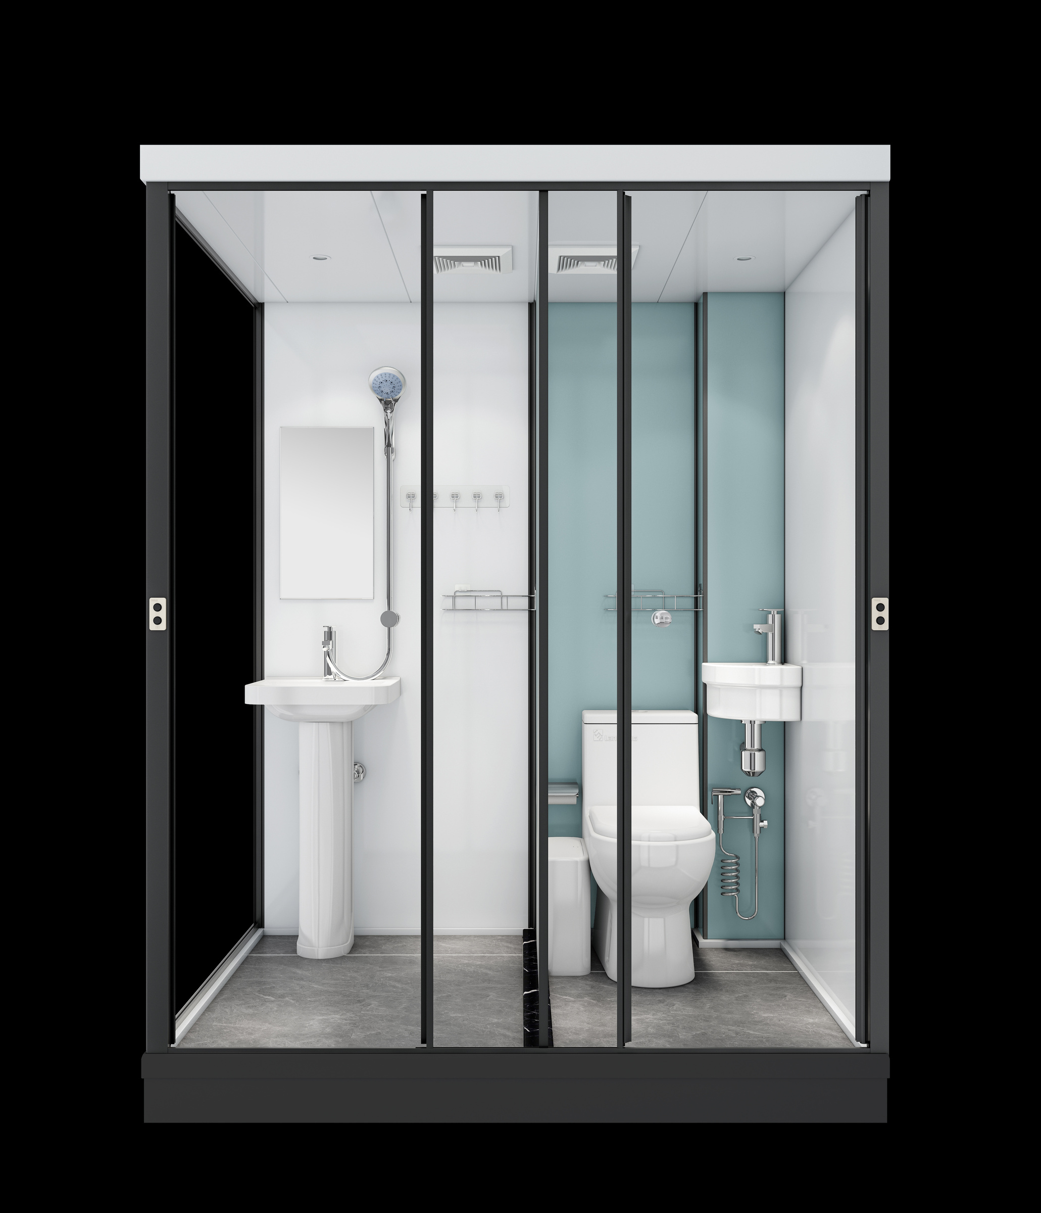
Model: MBR 409

Slide 14
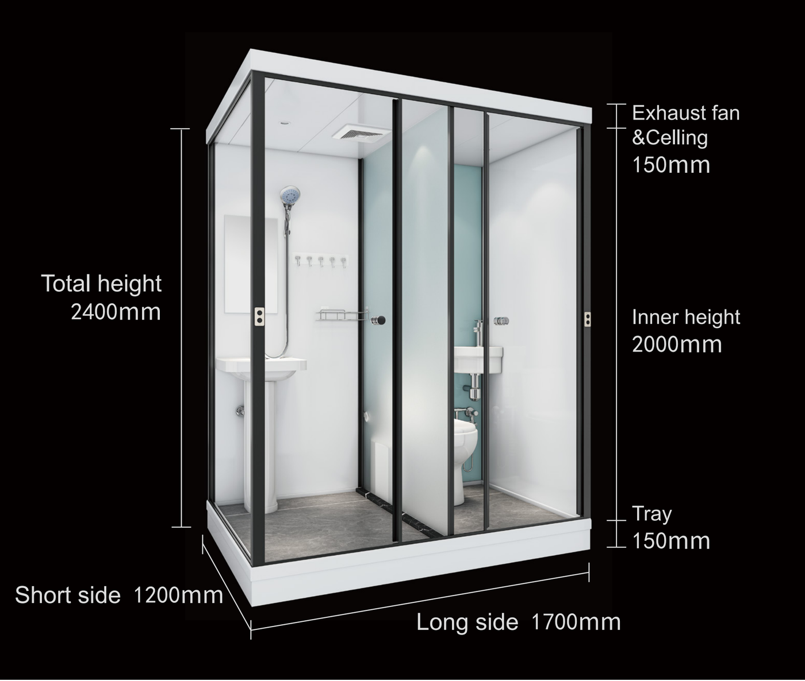
Model MBR 496
MBR 400
MBR 409
Model MBR 409
Overview
5.9 inches
Suitable for all prefab buildings
Size and Specifications
  Domes
  Yurts
  Tents
  Containers
  Air Domes
  Washing Area combined w. Bathroom area
  Toilet Area
  Sliding Door
  Separation Wall
94.5 in
78.7 inches
Left & right side configuration
All-in-one bathroom unit
5.9 inches
47.2 in
67 inches

Slide 15
Model MBR 496
MBR 400
MBR 409
Model MBR 409
Gallery

Slide 16
Order.
Contact us at info@domespaces.com
or call +15618071969 (Americas) or +443300272104 (Europe/Middle East)

